Slide 1
Great Cores
And paths

Slide 2
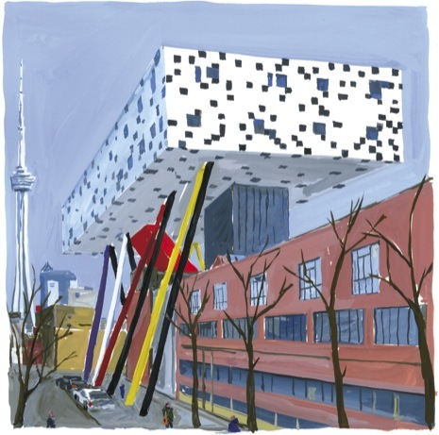
Will Alsop
Sharp Center
Toronto
Megastructure in the New Yorker http://www.newyorker.com/arts/critics/skyline/2007/10/22/071022crsk_skyline_goldberger

Slide 3
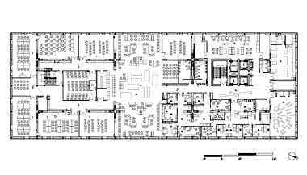
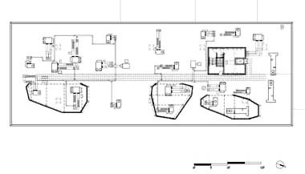
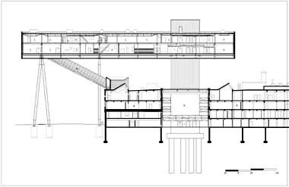
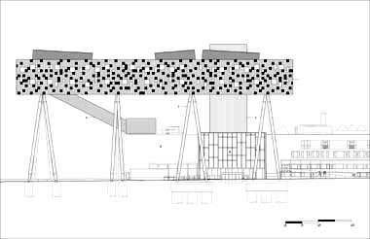
toilets
Fire stairs
elevators

Slide 4
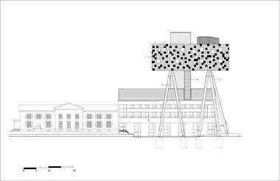
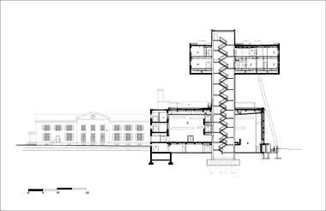

Slide 5
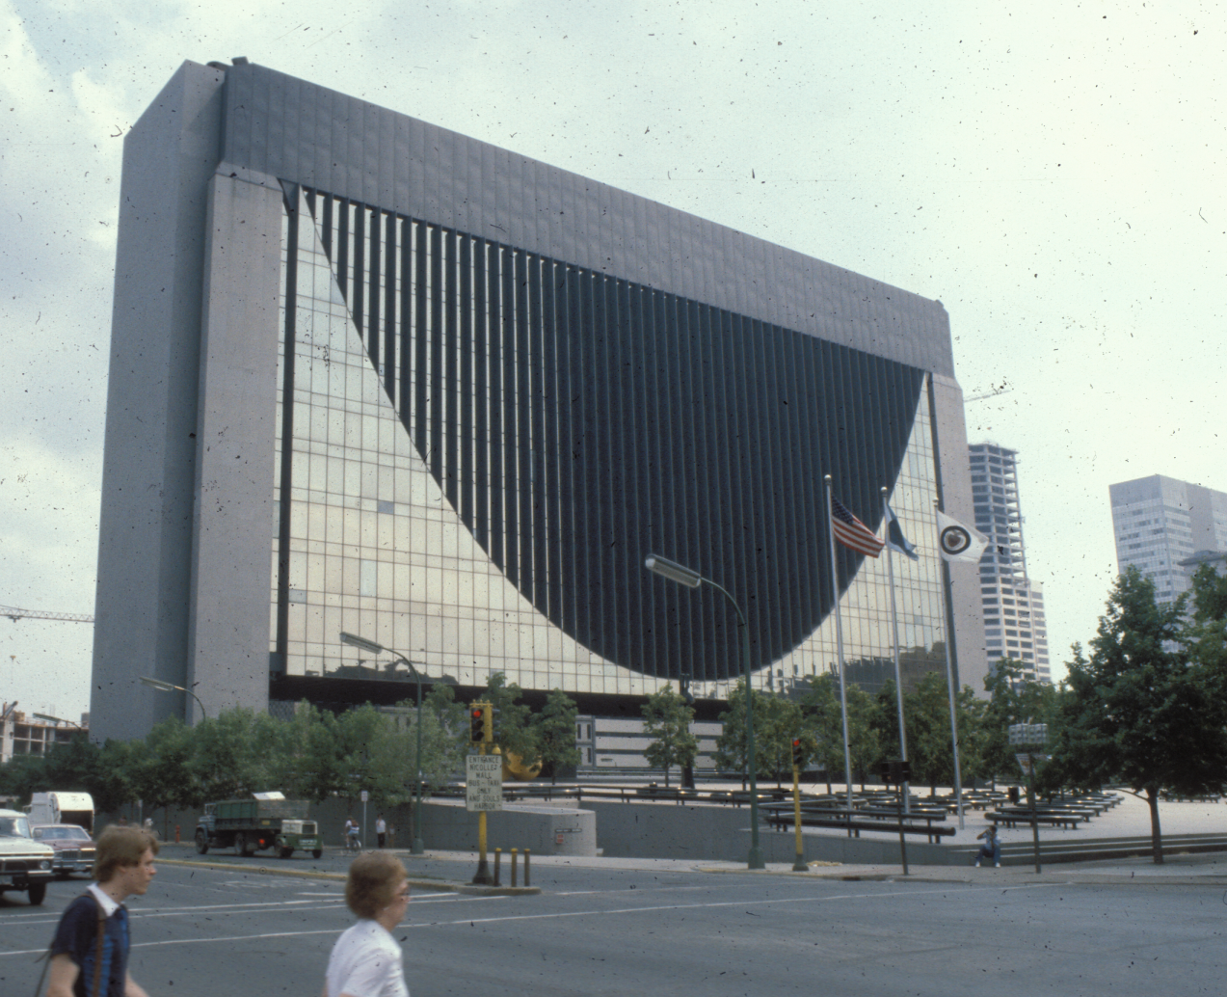

Slide 6
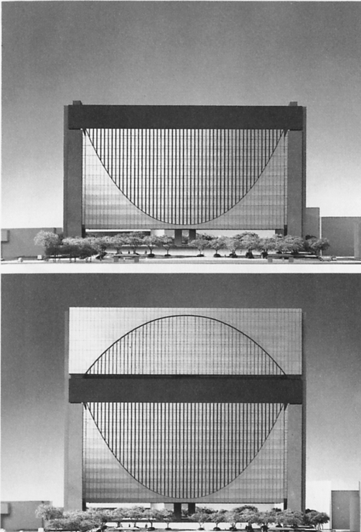

Slide 7
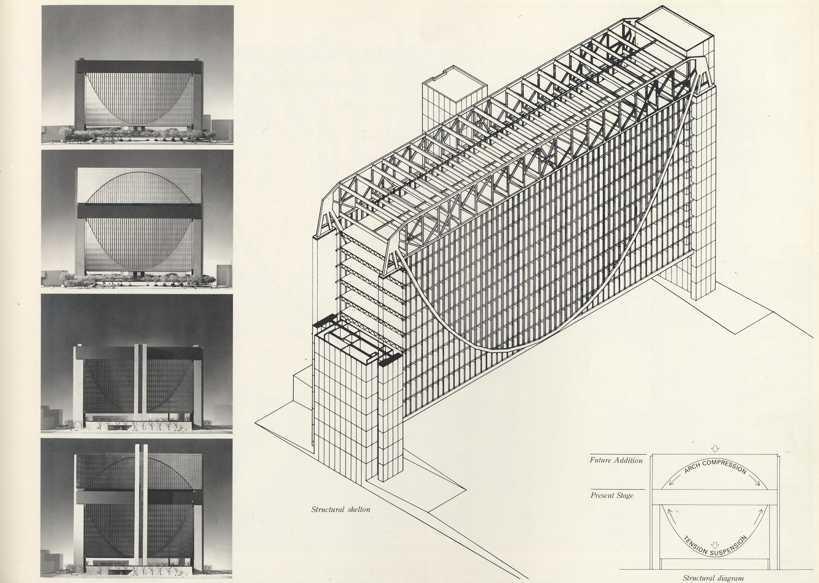

Slide 8
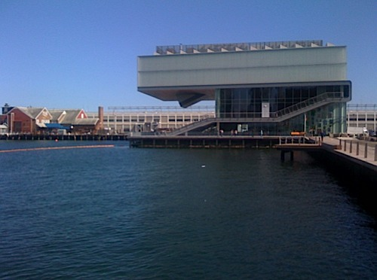

Slide 9
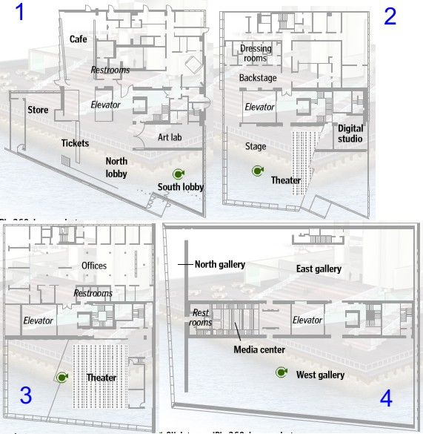
toilets
Fire stairs
elevators

Slide 10
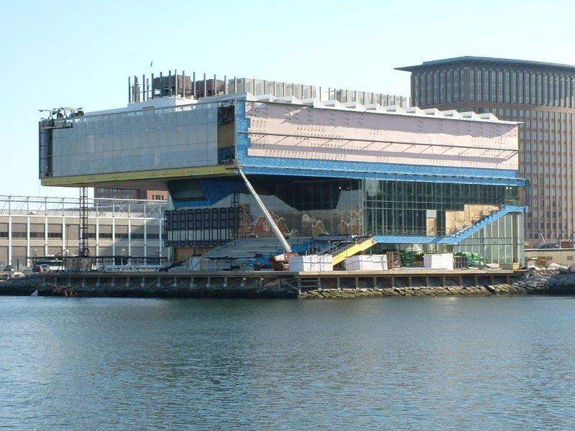
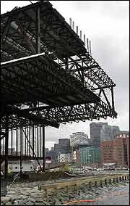

Slide 11
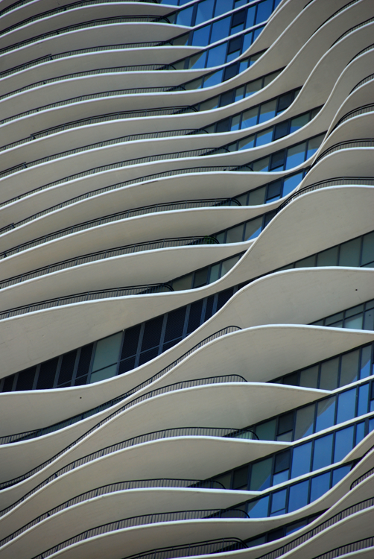
The future of incremental change: Aqua, Jeneanne Gang, Architect

Slide 12
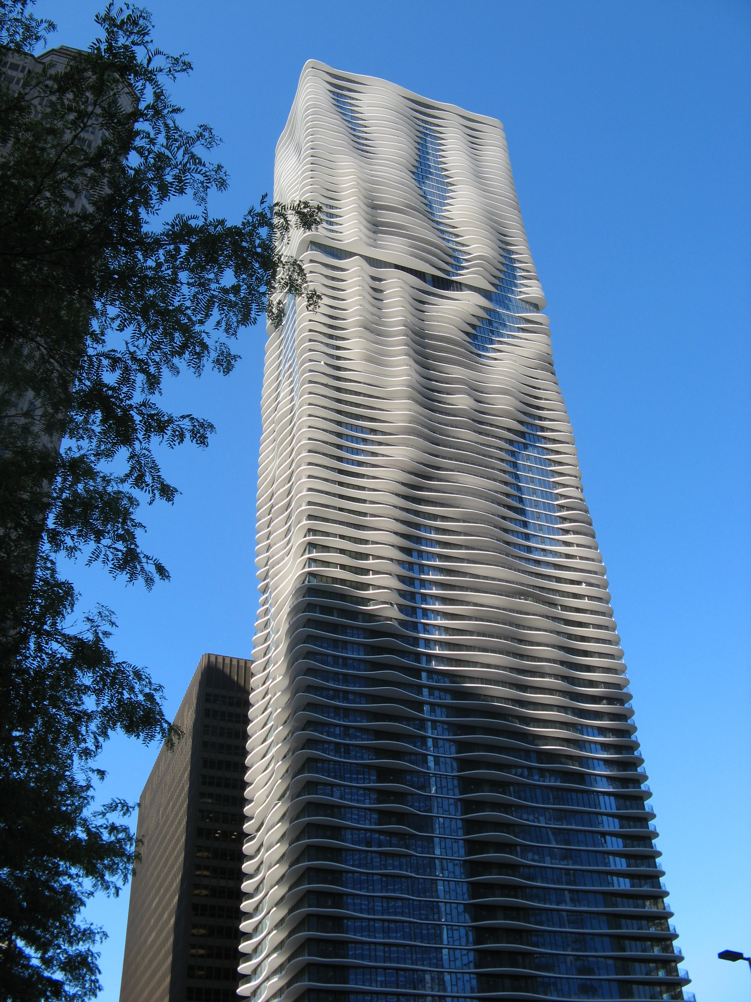
Cantilever variably to 12 feet…that’s all you need

Slide 13
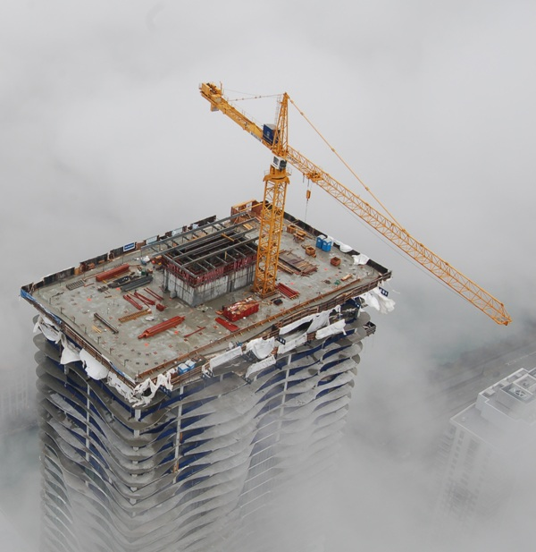

Slide 14
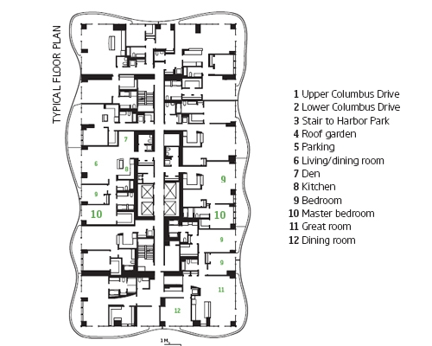
toilets
Fire stairs
elevators

Slide 15
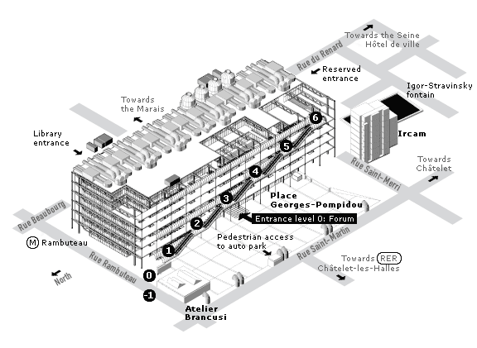

Slide 16
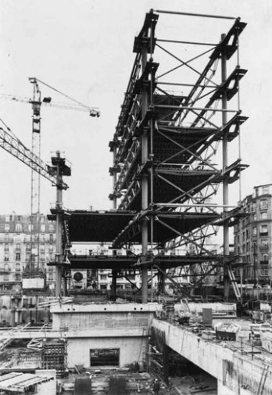

Slide 17
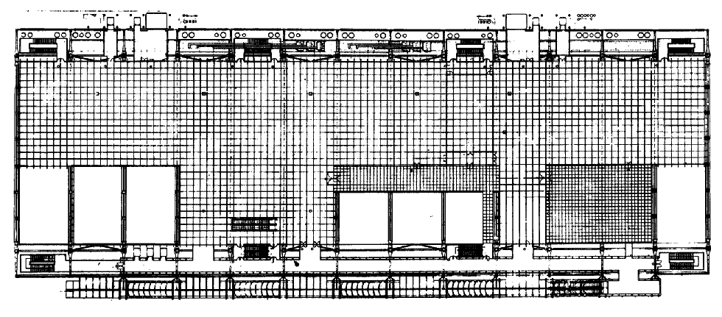
elevators
Fire stairs
toilets

Slide 18
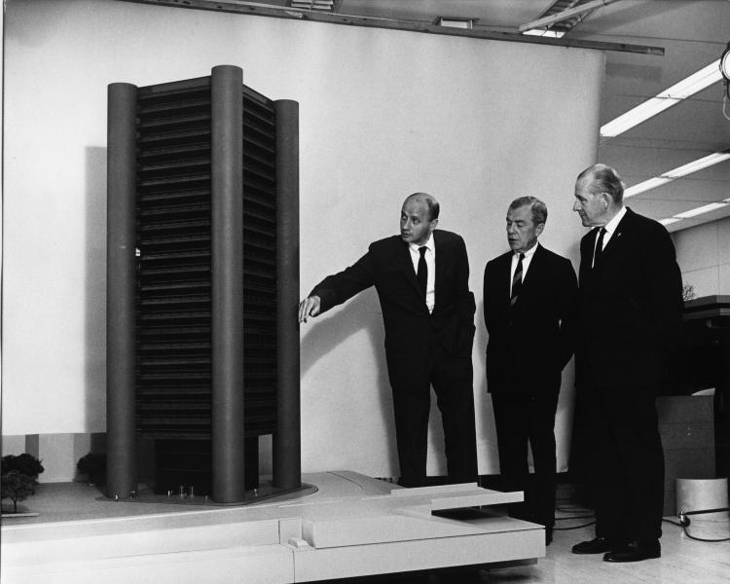

Slide 19
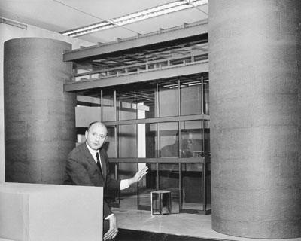

Slide 20
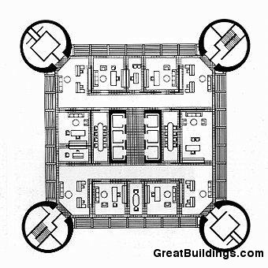
elevators
Fire stairs
toilets

Slide 21
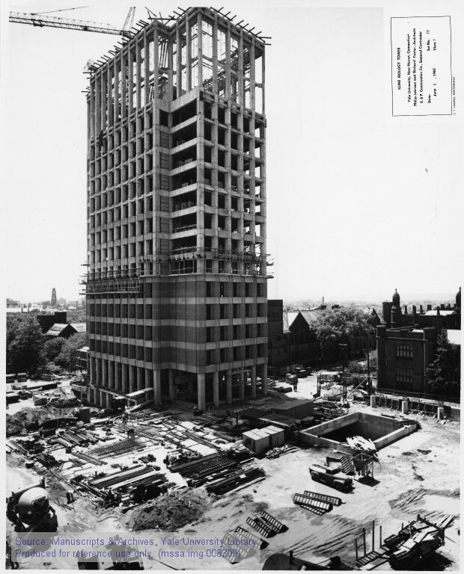

Slide 22
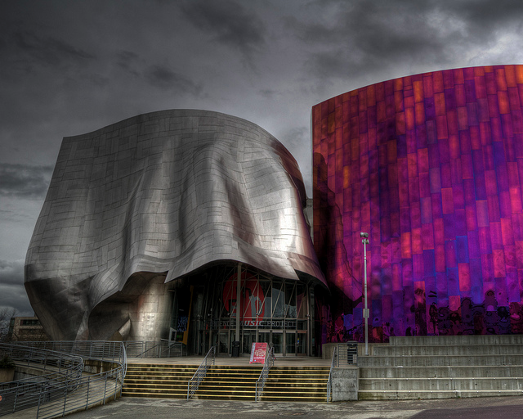

Slide 23
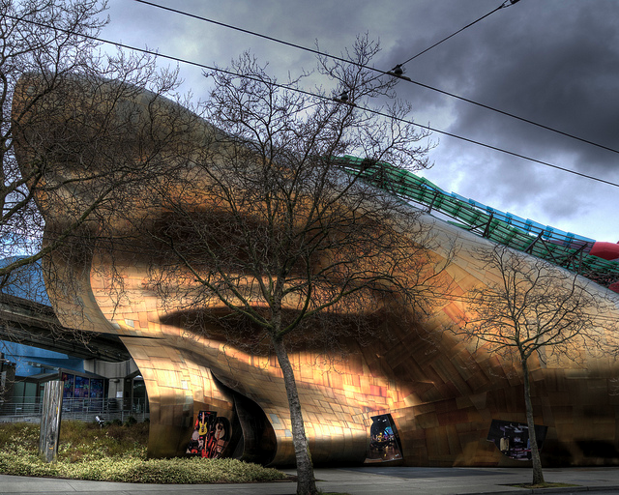

Slide 24
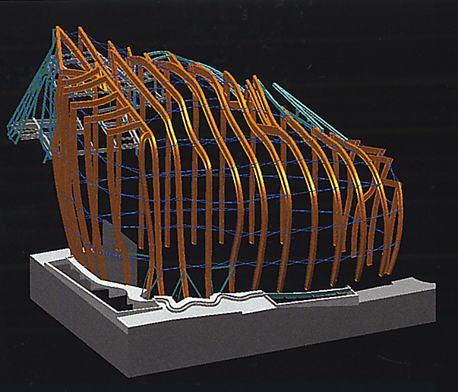
Catia makes “noodle” WF steel columns, to get close (1 to 35 feet) to the form
then mediating structure fills between noodles and skin.

Slide 25
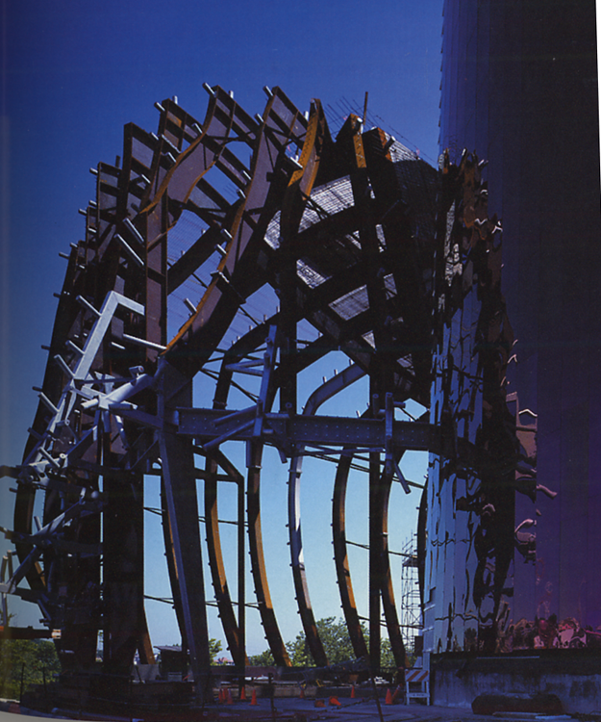
The steel industry bends, splices, rolls, and sometimes welds up the “noodles columns” out of steel plate, or wide flange members.
Gusset plates are welded into the web where the steel changes direction in order to add stiffness to the noodle
Steel pipe stanchions are added to support tubes that will carry the metal skin

Slide 26
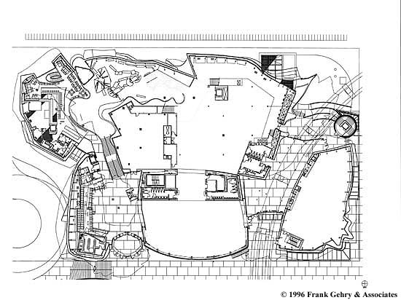
elevators
Fire stairs
toilets

Slide 27
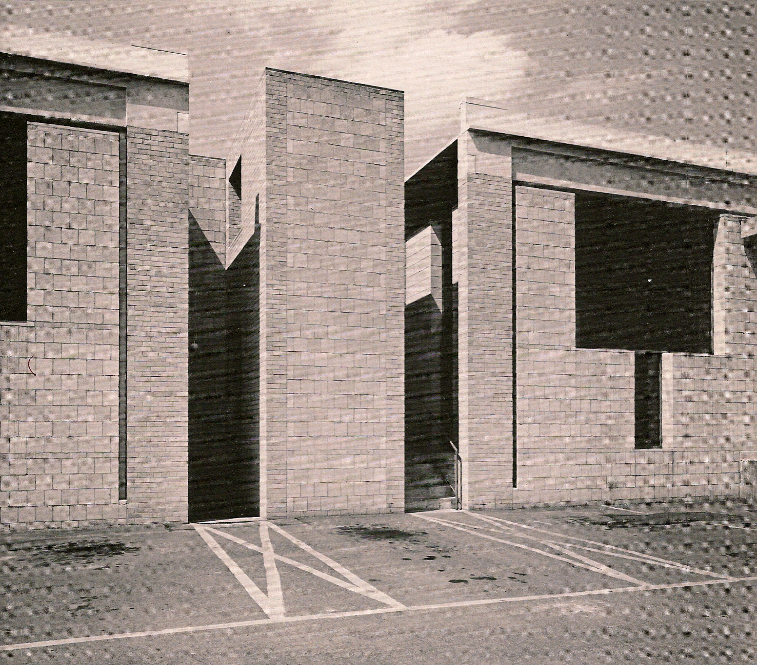

Slide 28
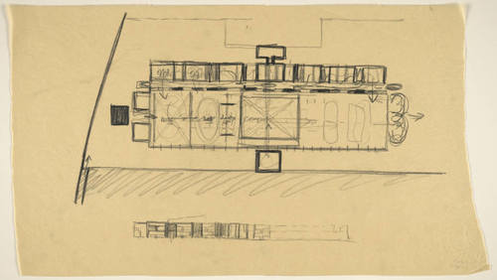

Slide 29
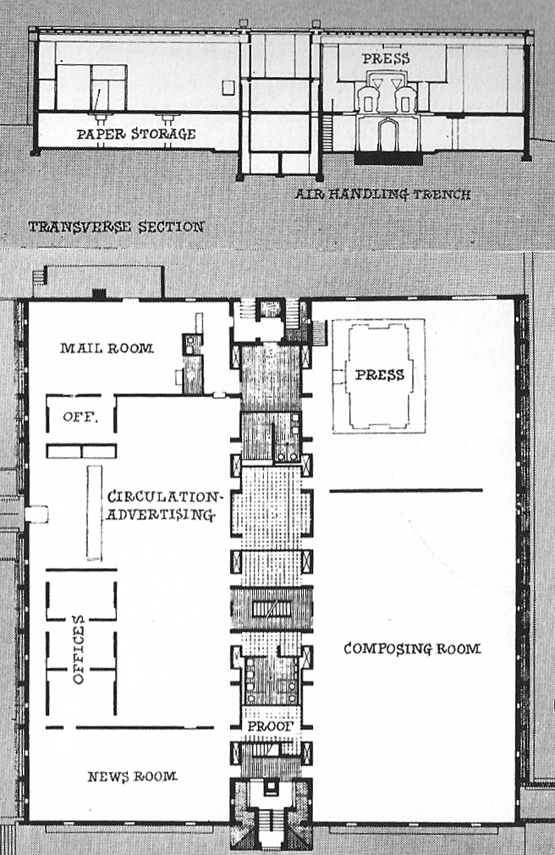
Fire stairs
toilets

Slide 30
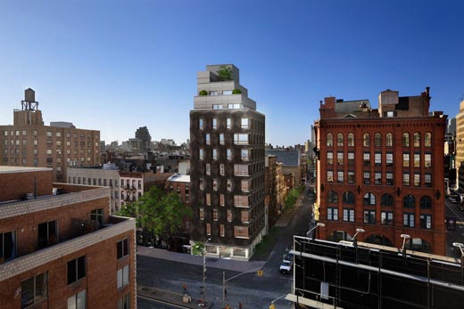
Historic context
Masonry mandate
Real estate pressure for thinness
Zoning for corbels
(10.s.f of each 100 s.f. may extend beyond the property line)
…provokes a 10 inch ripple
290 Mulberry Street, SHOP Architects (Steve Sanderson)

Slide 31
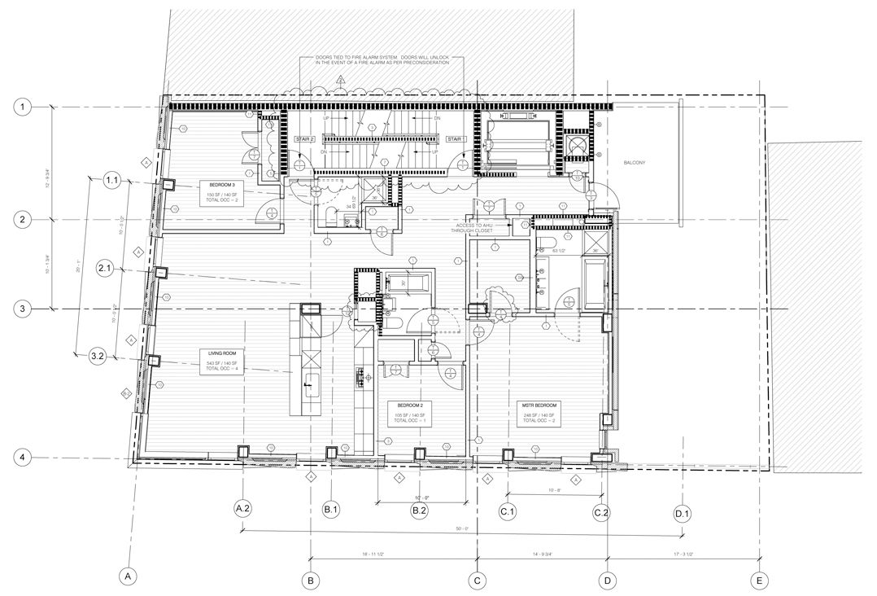
elevators
Fire stairs
toilets

Slide 32
